Slide 1


Basics of JavaScript Karthick

Slide 2
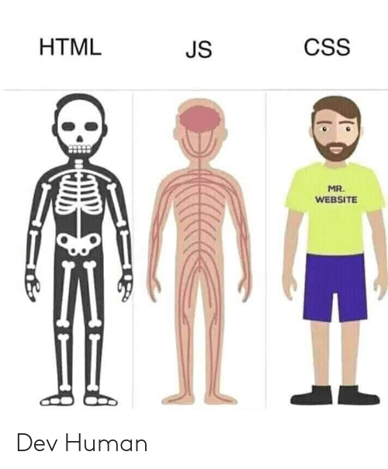
The Three Layers of the Web
1. HTML : The Structure Layer
2. CSS : The Styles Layer
3. JavaScript : The Behavior Layer

Slide 3
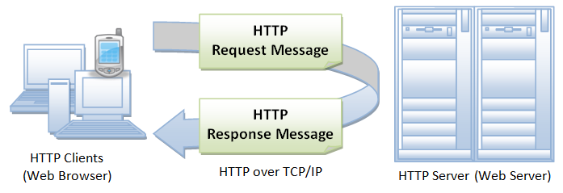
Introduction
JavaScript is a powerful client side scripting language
JavaScript is a best supported scripting language for many browsers
It can be written inside <script> tag or in a file with extension .js
JavaScript is usually embedded directly into HTML page

Slide 4
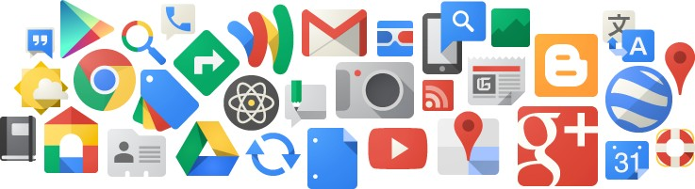
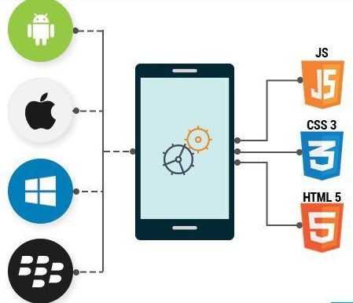
Who uses JS?
Web Applications
Web apps that load a single HTML page and dynamically update that page as the user interacts with the app
Best examples can be Google products.
Mobile Applications
Native or Hybrid android and iOS application
React Native, Ionic, Meteor

Slide 5
Who uses JS?
Server Side
Node.js is a powerful tool that can run JavaScript applications on both the server side as well as the client side
Animation
An animation can be implemented as a sequence of frames – usually small changes to HTML/CSS properties
Gaming
The combination of JavaScript and HTML5 makes JavaScript popular in games development as well

Slide 6
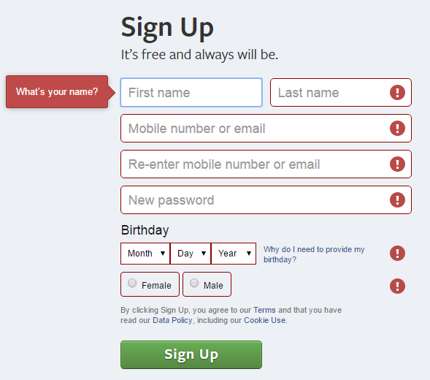
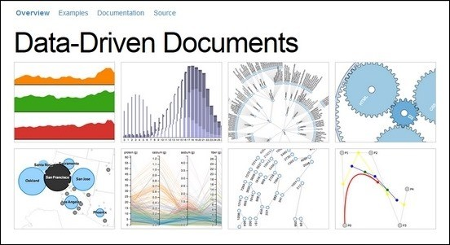
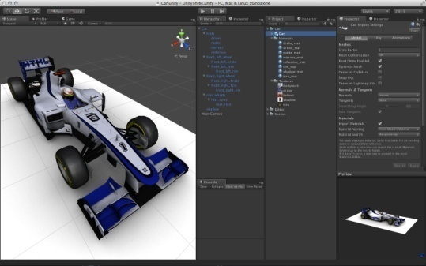
What can JS do?
Form Validations
3D Animations
Virtual Reality
Data visualization
Gaming

Slide 7
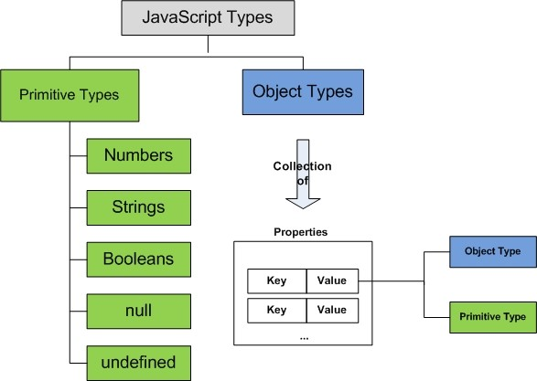
Language fundamentals
Data Types
Number
String
Boolean
null
undefined
Object Type
Function
Array
Object

Slide 8
Language fundamentals
Data Types
Number
String
Boolean
null
undefined
Object
Numbers
Double-precision 64-bit format [ Int and floats]
Leads to problems this
0.1 + 0.2 == 0.30000000000000004
- All standard arithmetic operators ( + , - , * , / , % )
- Math Object , Math.sin() , Math.round() , Math.floor() etc
parseInt() , parseFloat() for parsing string to numbers
Special Numbers - NaN , Infinity
Function
Array
Date
RegExp
String
- Sequences of 16 bit Unicode chars . It will support any language.
- String has a lot of built in functions, properties .
Boolean
Coerce any thing into Boolean using Boolean()
Falsy Values : false, 0, “”,NaN, null, and undefined
Truthy Values: Everything else

Slide 9
Language fundamentals
Data Types
Number
String
Boolean
null
undefined
Object
Declaring a variable
var a;
var b = 10;
b = “Hello World”
console.log(a) // Would show undefined - Means its declared but not defined
null
- Is an assignment value.
- Can be used for explicitly saying at a point of execution that variable is not available or doesn't have an actual value.
Function
Array
Date
RegExp
null undefined
absence of value for a variable; absence of variable itself;

Slide 10
Language fundamentals
Data Types
Number
String
Boolean
null
undefined
Object
Object
Everything is an object in JS. Even Functions
Simple collections of name-value pairs
Primitives are immutable
var | obj | = | new | Object ();
var | obj | = | {};
function Person(name, age) {
this.name = name;
this.age = age;
}
var p1= new Person ("John" , 24);
Function
Array
Date
RegExp
TIP: All object assignments are References . i.e when you do
var | p2 | = | p1 | // | This | will | point | to | same | place | in | memory

Slide 11
Language fundamentals
Data Types
Number
String
Boolean
null
undefined
Object
Functions
function add(x, y) {
var total = x + y;
return total;
}
var add = function(x, y) {
var total = x + y;
return total;
}
This that you can do :
add(3,4) add(“hello”,”world”)
// will return 7
// will return “helloworld”
Function
Array
Date
RegExp
Functions are a collection of JavaScript statement that performs a specified task

Slide 12
Language fundamentals
Data Types
Number
String
Boolean
null
undefined
Object
Arrays [ ]
Special type of Objects.
Has a special property called length
length is not the number of elements of array
It is one more than highest index in the array
var arr = new Array(); arr[0] = 1;
arr[1] = ‘b’;
arr[50] = new Object(); arr[99] = true; console.log(arr.length)
// Arrays dont have a type. You have have
// primitives or objects as array elements
Function
Array
Date
RegExp
// Length would be 100 when actually there
// are only 4 elements in the array

Slide 13
Language fundamentals
Data Types
Number
String
Boolean
null
undefined
Object
Date
- Exact replica of Java date class.
new Date() gives you the timestamp accurate to milliseconds from 1/1/1970
new Date(10-1-2015) gives you a date object with that days timestamp
Lots of date manipulation functions inbuilt.
Regular Expressions
One of the least exploited parts of JS.
Good for form validation .
Can be used along with String.replace method
Function
Array
Date
RegExp

Slide 14
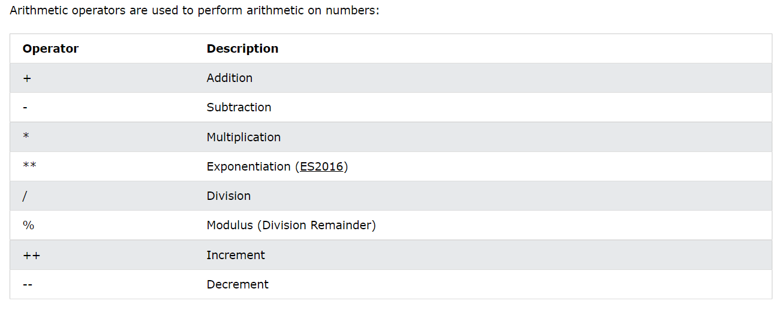
Arithmetic Operator

Slide 15
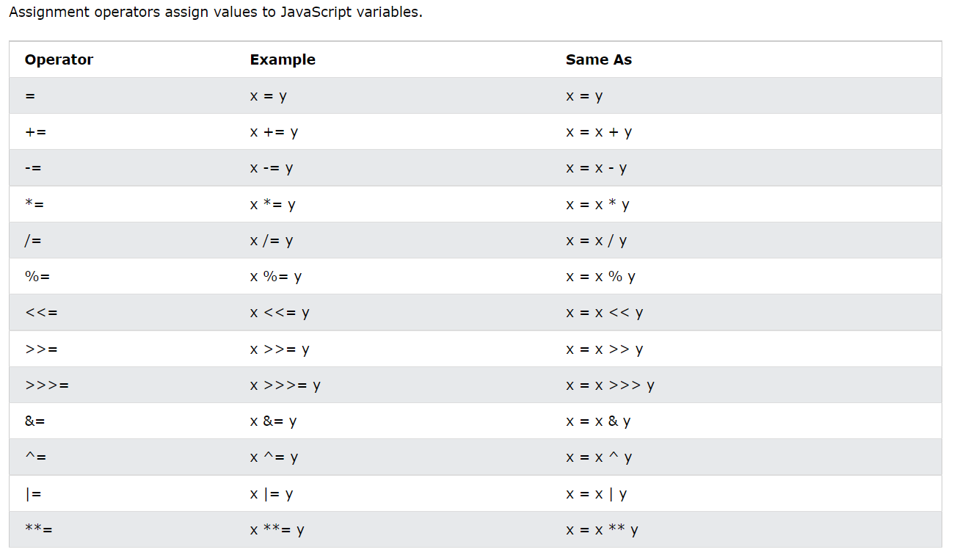
Assignment Operator

Slide 16
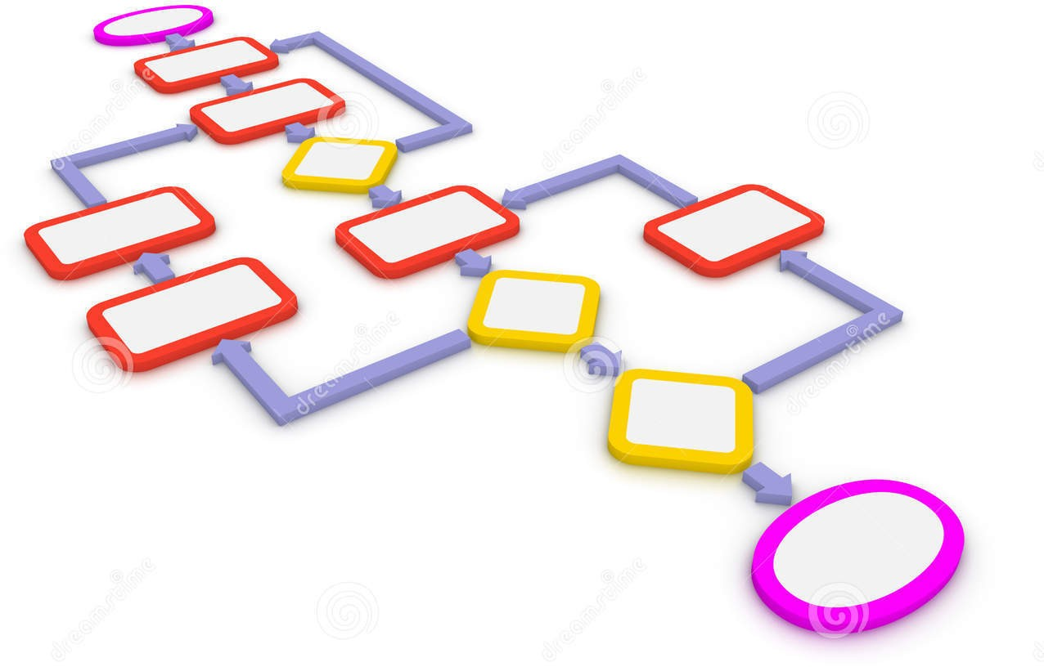
Flow Control
Support for almost every flow control structure.
Including :
if then else
for
ternary operator switch case
for in break continue

Slide 17
Iterations
if...else
The if statement executes a statement, if a specified condition is truthy. If the condition is falsy, another statement can be executed.
Multiple if...else
for
A for loop repeats until a specified condition evaluates to false
for...in
The for...in statement iterates the properties of an Object.
for...of
The for...of statement iterates the list of values in Array.

Slide 18
Iterations
while
A while statement executes its statements as long as a specified condition evaluates to true.
do while
It loops through a block of code once, and then repeats the loop while a specified condition is true
switch
The switch statement executes a block of code depending on different cases.

Slide 19
Scope
Scope is the set of variables you have access to.
In JS there are mainly three scopes
Local Scope
Global Scope
Automatic Global
Any variable declared inside a function using var has local scope
Any variable declared outside it has global scope
Special Case : Any variable declared inside a function without the “var“ keyword is assumed global and is assinged to global scope.
function foo(){
var a =10; // Local scope
var b = 100; // Global scope function bar(){
c = 10; // Automatic global
}
}

Slide 20
Hoisting
Hoisting is JavaScript's default behavior of moving declarations to the top.
Variable Hoisting
Function Hoisting
var declaredLater;
// Outputs: undefined
console.log(declaredLater);
declaredLater = "Now it's defined!";
// Outputs: "Now it's defined!"
console.log(declaredLater);
// Outputs: "Definition hoisted!"
definitionHoisted();
// TypeError: undefined is not a function
definitionNotHoisted();
function definitionHoisted() { console.log("Definition hoisted!");
var definitionNotHoisted = function () { console.log("Definition not hoisted!");
}
};

Slide 21
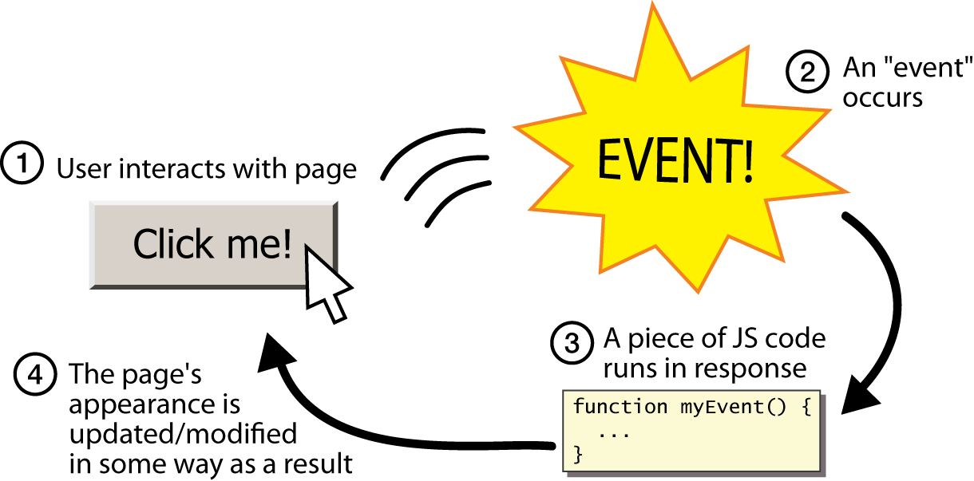
Event-driven programming

Slide 22
Event handlers
<button onclick=“onClickButton();">Click me!</button> HTML
function onClickButton() {
alert(“You have clicked button!");
} JS
When you interact with the element, the function will execute
onclick is just one of many event HTML attributes

Slide 23
Events
onsubmit - call when submit button is clicked
onclick - call when this button is clicked
onreset - call when the reset button is clicked
onload - call after page loads
onmouseover - call when mouse pointer enters image area
onmouseout - call when mouse pointer leaves image area
onfocus - call when control receives focus
onblur - call when a control loses focus
onchange - call when a control loses focus and the value of its contents has changed
many more

Slide 24
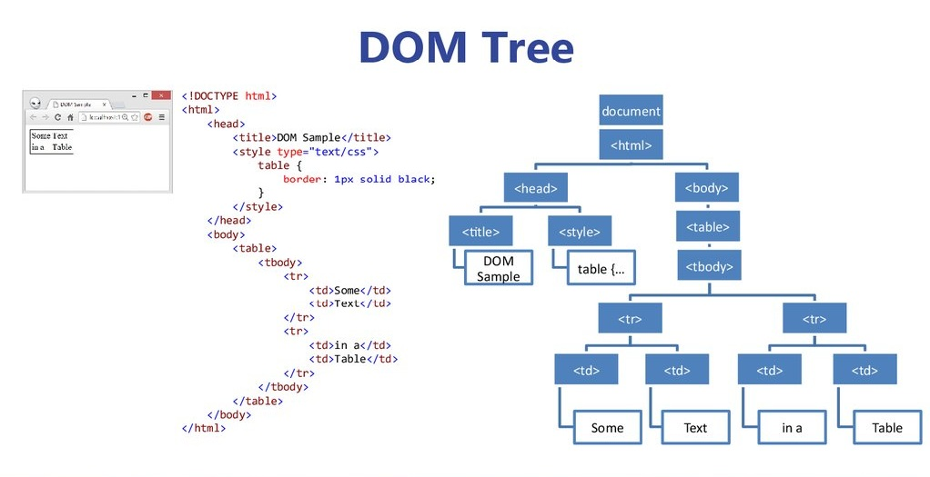
Lets talk about the DOM
When a web page is loaded, the browser creates a Document Object Model of the page.
The HTML DOM model is constructed as a tree of Objects
The HTML DOM is a standard for how to get, change, add, or delete HTML elements

Slide 25
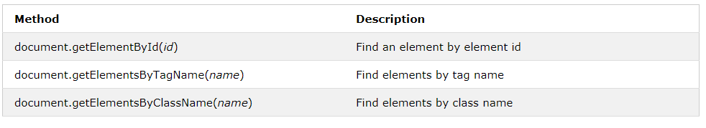
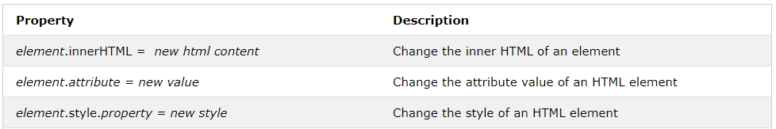
DOM Methods
Finding HTML Elements :
Changing HTML Elements :

Slide 26
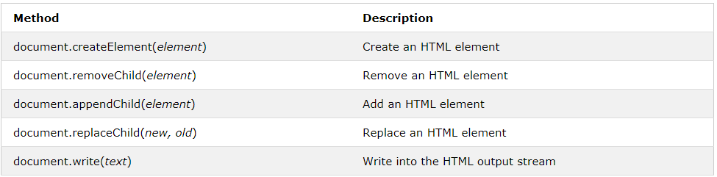
DOM Methods
Adding and Deleting Elements :

Slide 27
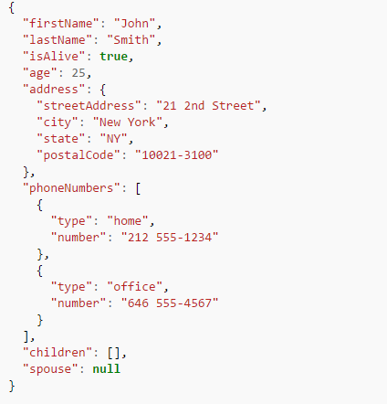
JSON
JavaScript Object Notation
JSON is a syntax for storing and exchanging data
JSON is text, and we can convert any JavaScript object into JSON, and send JSON to the server
We can also convert any JSON received from the server into JavaScript objects.

Slide 28
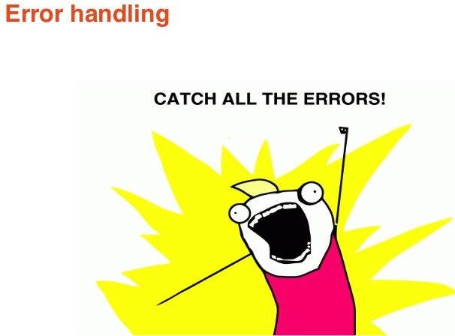
Error Handling
Best way to handle errors is to write good code.
Next best way is to use try catches
try {
Block of code to try
}
catch(err) {
Block of code to handle errors
}
This ensures that rest of the code continues to execute . Otherwise your code will stop executing at the line where the error occurred . Leading to total disaster.

Slide 29
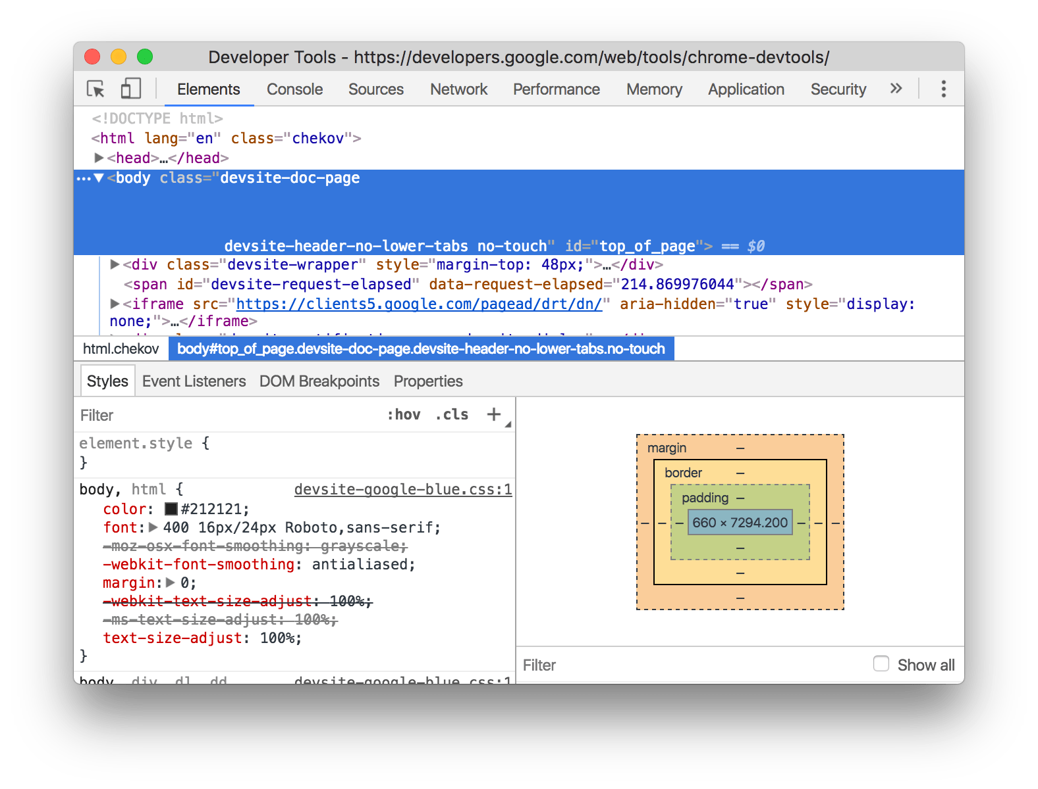
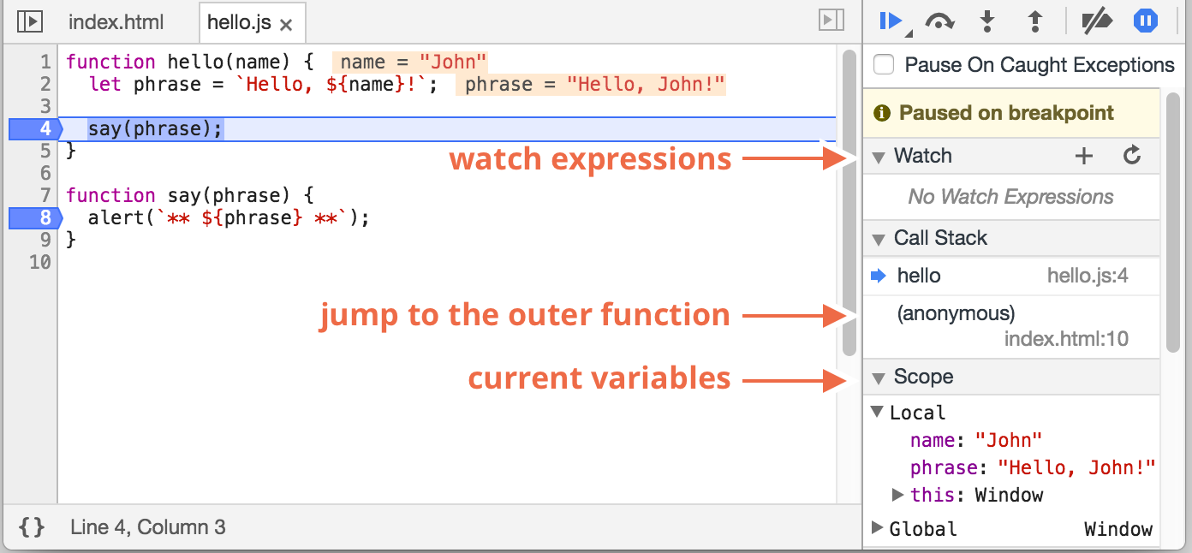
Debugging
F 12

Slide 30

Thankyou !

